Slide 1
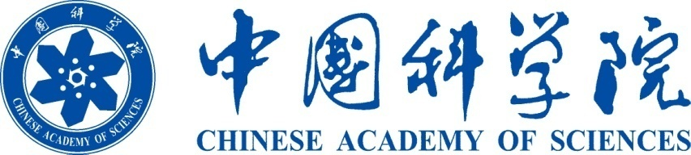







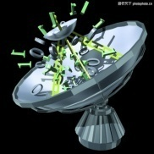
L/O/G/O
An Overview of
the Chinese Academy of Sciences

Slide 2

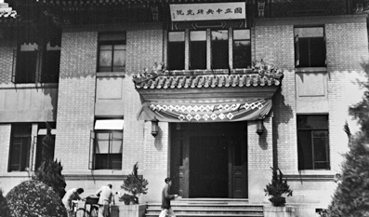
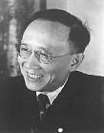
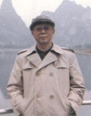


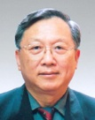

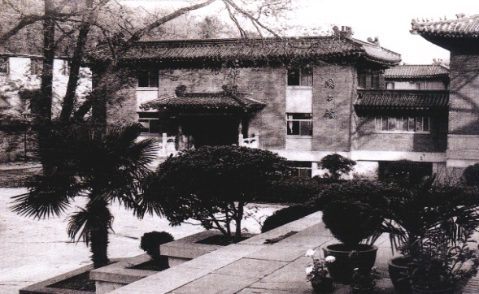
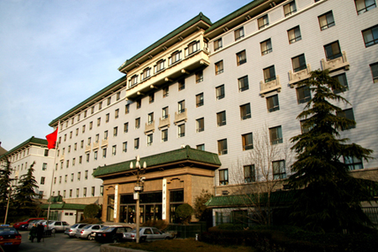
CAS: Cradle of Science and Innovation in China
Founded in Nov. 1949
Based on Academia Sinica and Beiping Academy
Home to the largest number of best talents
A powerhouse of scientific knowledge and innovation
1949 - 1978
Guo Moruo
1979 - 1981
Fang Yi
1981 - 1987
Lu Jiaxi
1987 - 1997
Zhou Guangzhao
1997 - 2011
Lu Yongxiang
2011-
Bai
Chunli
Academia Sinica (1928-1949)
CAS headquarters (1949-1979)
CAS headquarters (1979-)
2
Notes:
2

Slide 3




Mission, Structure and Strategy
Scientific
Excellence
High-caliber
Talent
Trusted
Ideas
Mission
Universities
Academy
Institutes
Structure
Strategy
Democracy
Talent
Openness
Structure
Mission
Three integrated elements: a large number of institutes, a merit-based academy and higher education institutions
Development Strategy: to run it with democracy, flourish it with openness and boost it with talent
Committed to excellent S&T, high-caliber talent and offering strategic advice to decision-makers
3

Slide 4
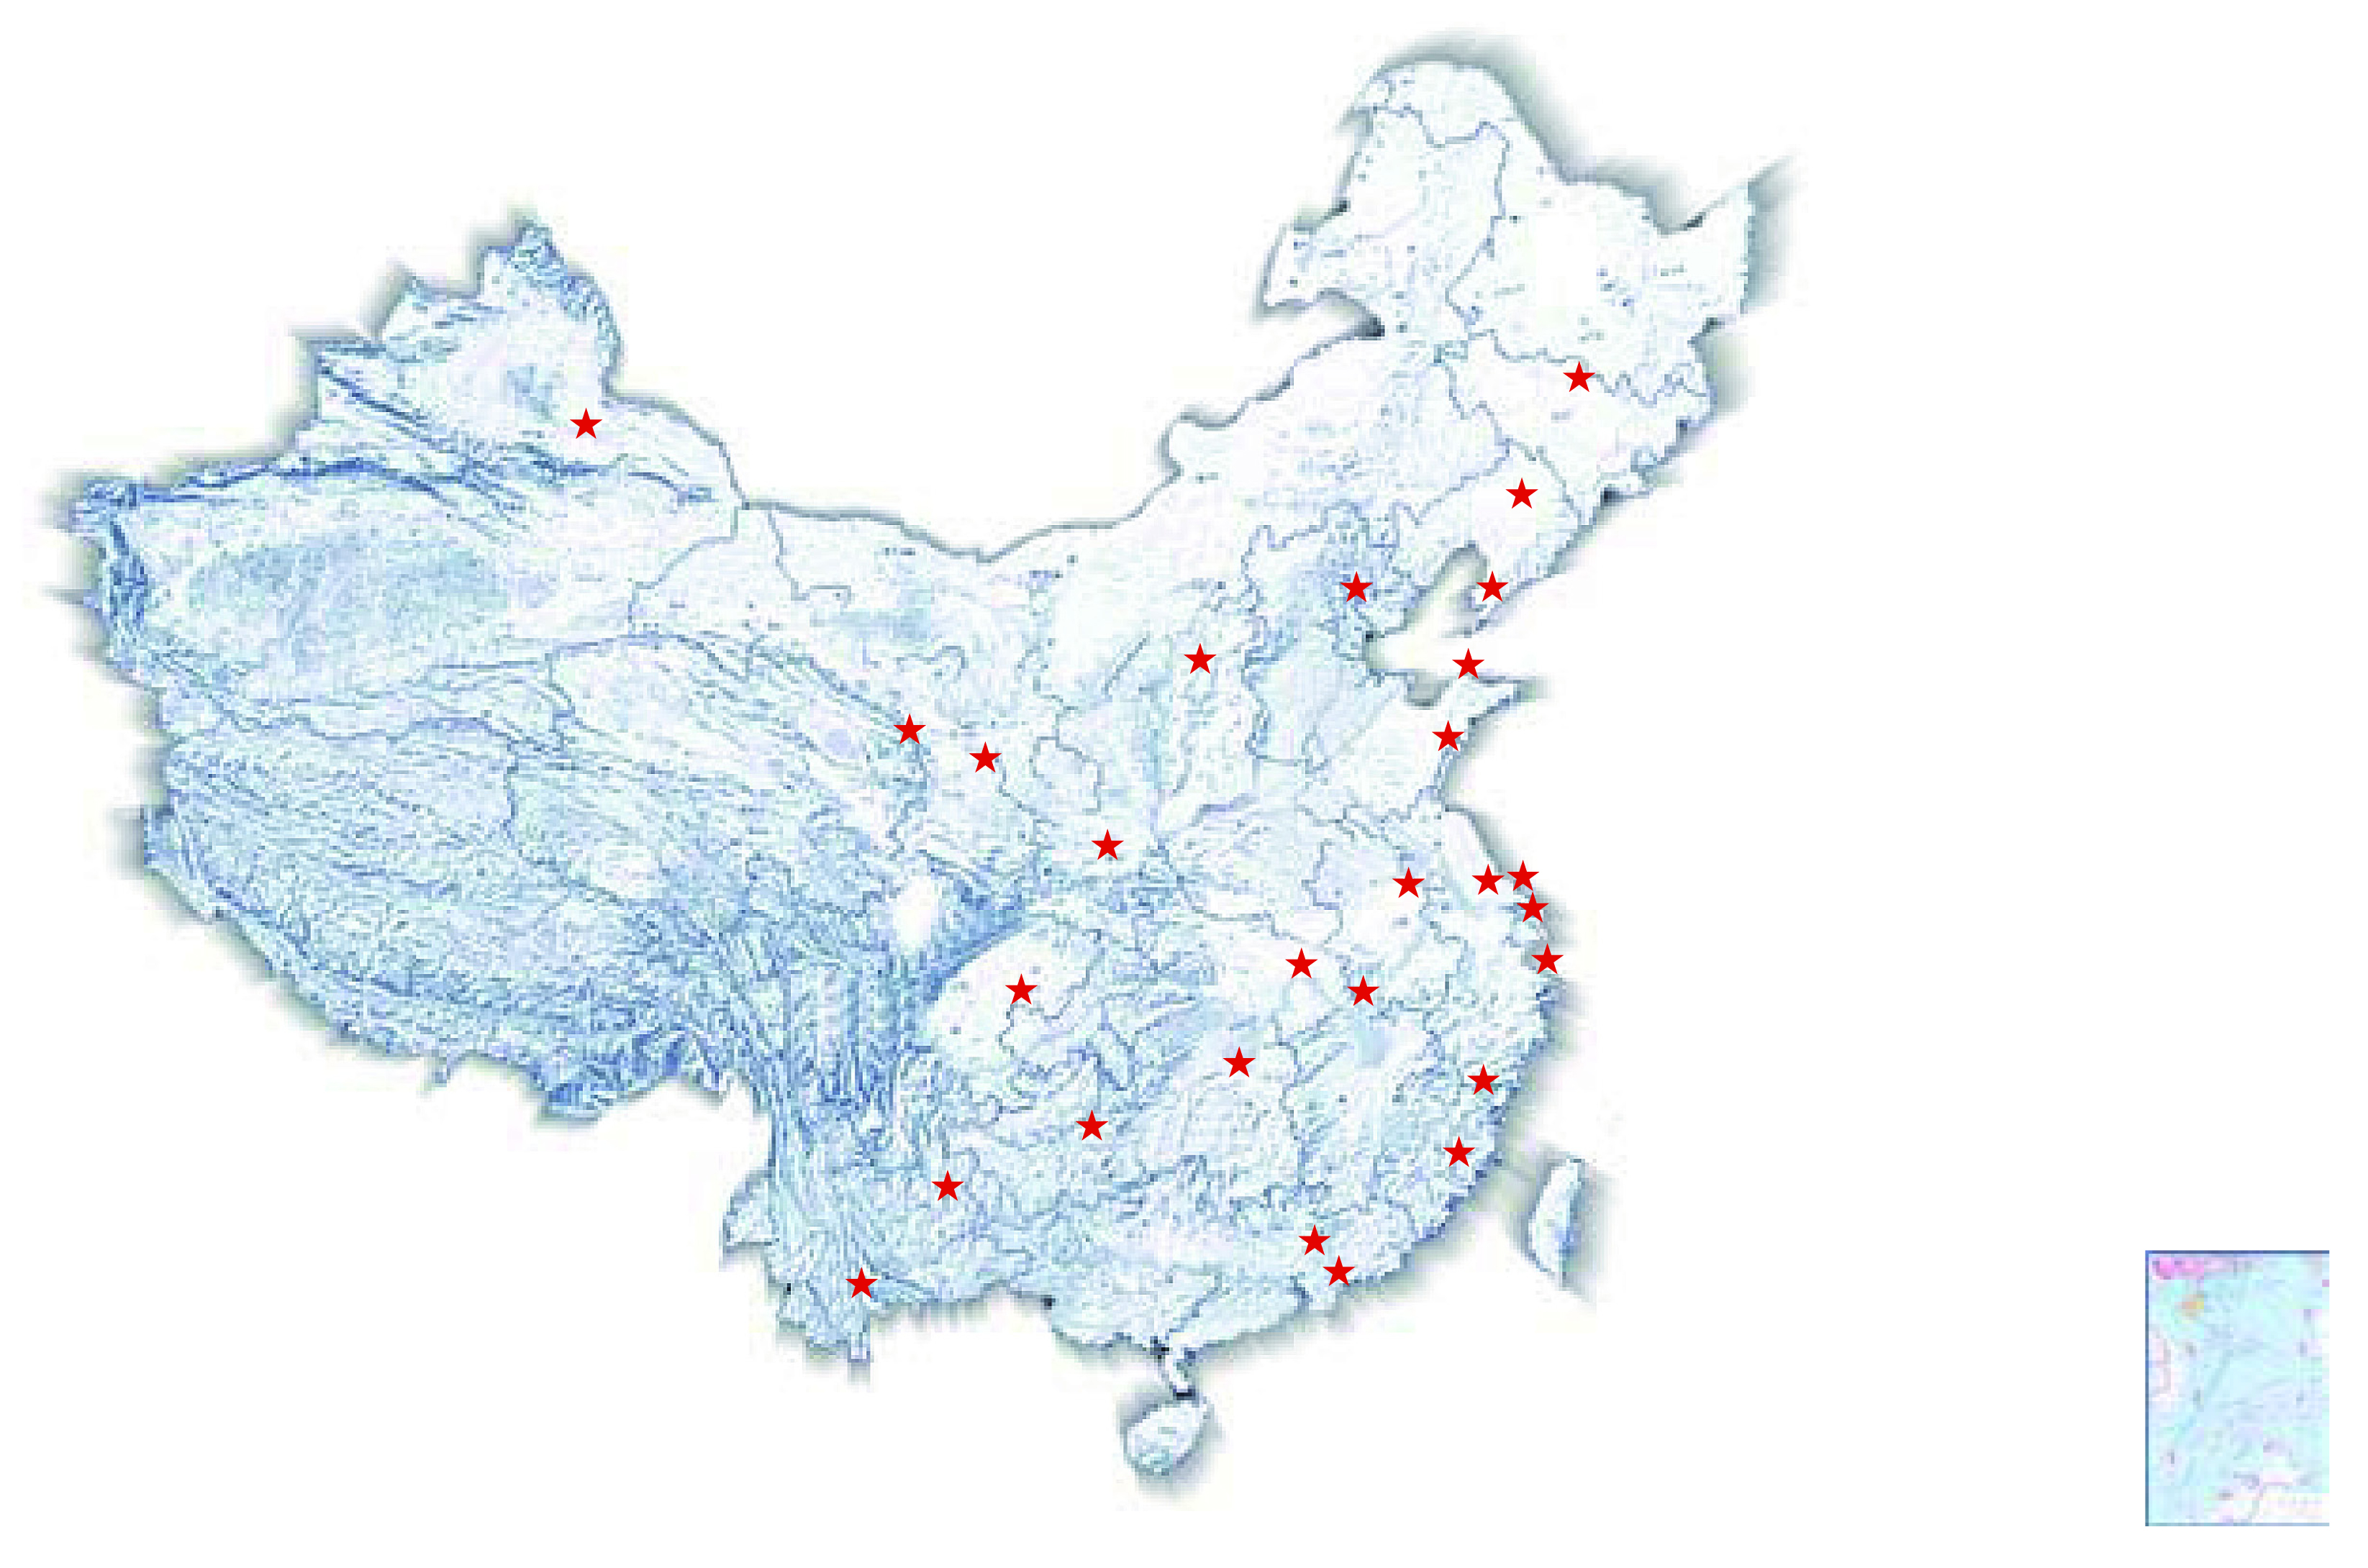
Facts & Figures (as of 2013)
104 Institutes
12 Regional Branches
2+1 Universities
89 State Key Labs
47 National Eng. Centers
13 Botanic Gardens
26 Herbariums
400+ Spin-off Companies
Distribution of CAS Institutes
Total staff: 64,700+
Graduate Students: 50,000+
CAS Members: 743
Foreign Members: 71
Budget : ~USD 8 Billion

Slide 5
Organizational Structure
Adhoc Committees
Committee for Education; Committee for Strategic Studies;
Committee for Academic Affairs;
Committee for Development Strategy
President
( Chairman of the Presidium of the Academy)
Presidium of the Academy
Vice Presidents
Secretary-General
Deputy Secretary-Generals
Executive Committee
of the Presidium
Bureau of Frontier Sciences and Education
Bureau of Major R&D Programs
Bureau of S&T for Development
Office of General Affairs
Bureau of Academic Divisions
Bureau of Development Planning
Bureau of Infrastructure, Logistics & Finance
Bureau of Personnel
Bureau of International Cooperation
Bureau of Science Communication
Bureau of Supervision and Auditing
Division of Mathematics and Physics
Division of Chemistry
Division of Life Sciences and Medicine
Division of Earth Sciences
Division of Information Technology Sciences
Division of Technological Sciences
Research Institutes
Educational Institutions
Supporting Organizations
CAS Holdings

Slide 6



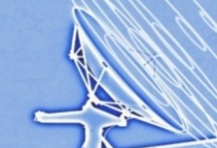
Research Portfolio
Physical Sciences
Earth and Envir. Sciences
Mathematics
Physics
Mechanics
Astronomy
Chemistry
Geology
Geography
Ecology
Oceanology
Atmospheric Sciences
Life Sciences
Engineering and Technological Sciences
Botany, zoology & microbiology
Genetics, genomics, proteomics and phenomics
Biomedical sciences
Agricultural sciences
Space science
Opto-electronics
Energy and materials
ICT
Great emphasis on interdisciplinary efforts to advance science and technology and tackle major S&T challenges

Slide 7
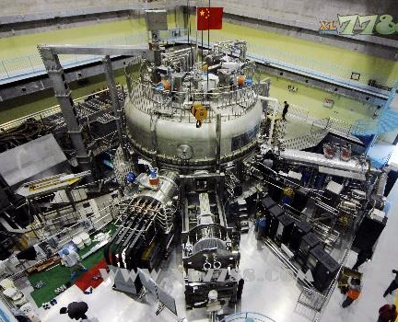
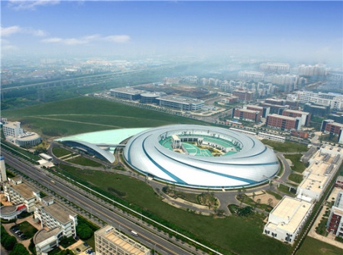
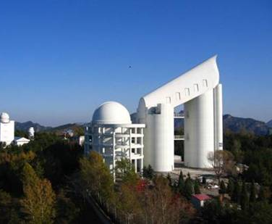
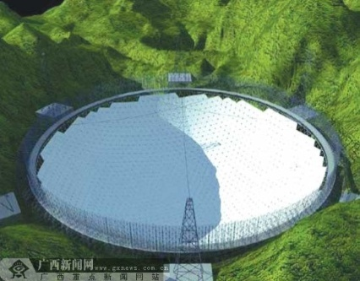
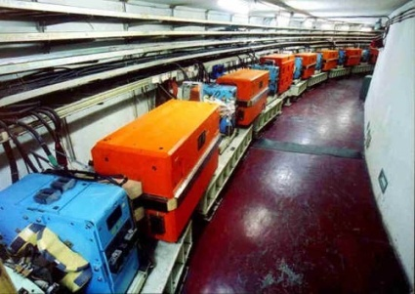
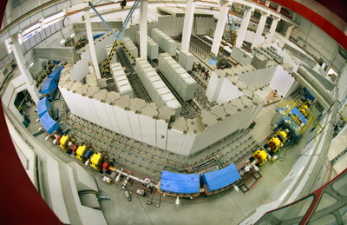
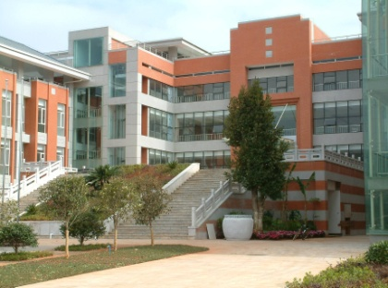
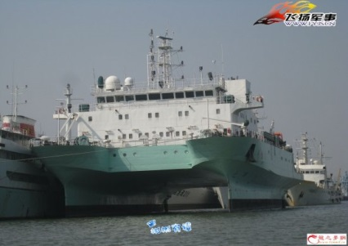
Mega-science Facilities
CAS operates over 85% of the large-scale science facilities in China
> 20 such facilities either in operation or in planning/construction phase
Cover various fields, such as particle physics, astronomy, synchrotron radiation, nuclear fusion and oceanography
EAST
SSRF
LAMOST
FAST
BEPCⅡ
HIRFL-CSR
Germplasm bank
ShiyanⅠ
Notes:
7

Slide 8
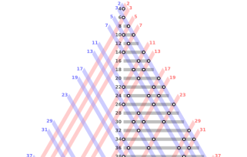
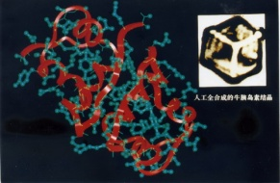
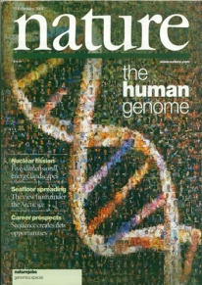

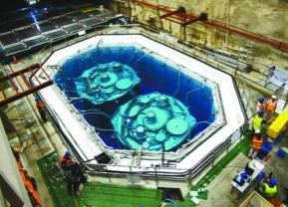



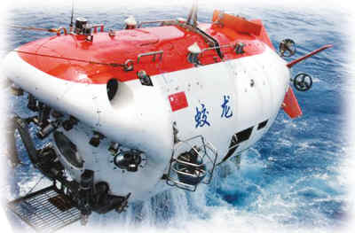
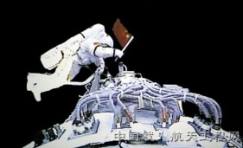
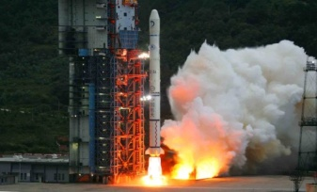
R&D Highlights
Historic breakthroughs:
Artificial synthesis of bovine insulin
A mathematical proof of Goldbach conjecture
1% of human genome sequencing
Recent highlights :
Quantum communication
Deep-sea submersible Jiaolong
Qinghai-Tibet railway construction
Discovery of new neutrino oscillation
90% of payloads on manned space missions

Slide 9
Higher Education & Talent Development
58,000+
Registered Students, incl.
50,000+
Postgraduates (50% are PhD students)
Talent Recruitment:
Hundred-Talent Program;
PIFI Program
Three Universities
(UCAS,USTC,
Shanghai UST)
CAS Members & Research Scientists
as mentors
HE Strategy & Uniqueness
UCAS: coursework at UCAS + research/dissertation work at CAS institutes
USTC: close interaction with CAS institutes
ShanghaiTech: partnership with Shanghai Municipal Government

Slide 10



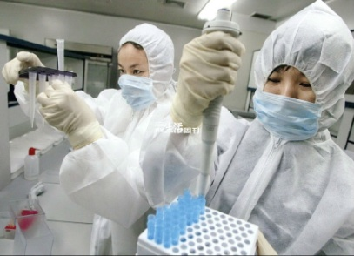
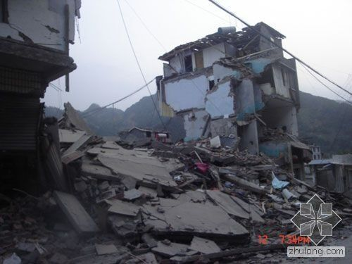
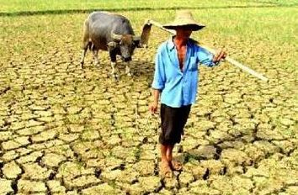

Scientific Advice and Policy
Play an important role in shaping national S&T policy and advising the Chinese government on national socio-economic development issues
National programs, initiatives, and major decision-making on S&T development
Socio-economic development and sustainability: energy, environment, health, etc
Middle and long-term development plans of scientific disciplines

Slide 11

Technology Transfer and Commercialization
Translate research results into value-added technology and products
Partner with local government and industry
Establish joint research institutes, technology transfer centers and incubation centers
Serve regional economic development
With local government | Jointly established institutes | 11
 | CAS technology transfer or incubation centers | 28
 | Institute-level technology transfer or incubation centers | 349
With industry | Institute-level technology centers or engineering centers | 392
Sales revenue and profit as a result of
CAS technology transfer
Top 6 major fields for technology transfer
Novel materials
Advanced manufacturing
Biomedicine and medical equipment
Agricultural technology
Electronics and IT Technology
New energy technology
Notes:
11

Slide 12
National Ranking---by publication
2013 Nature Publishing Index for Institutions in China
CAS (1)
University of S&T of China (2)
Tsinghua University (3)
Peking University (4)
Nanjing University (5)
Fudan University (7)
Zhejiang University (8)
Xiamen University (9)
Shanghai Jiaotong University (10)
Sun Yat-sen University (11)
Hong Kong University (13)
The Chinese University of HK (14)
Source: 2013 Nature Publishing Index

Slide 13
National Ranking---by patents
2001-2010 Patent Applications & Patents
By CAS and top Chinese Universities
Source: CAS Patent Analysis System, searched on Nov. 19, 2011
CAS Patent Statistics Report 2012

Slide 14
International Ranking---by publication in top journals
CAS, with 2,661 articles published in 68 high-quality journals, continues to top the China index list according to Nature Index China 2014, and is third in the world list (after CNRS and MPS)
By 2013 weighted fractional count (WFC), CAS tops the world list (WFC gives a measure of the relative contribution to each paper)

Slide 15
International Cooperation
Effective means of maximizing our potential, making contributions to advancing global science and addressing global challenges
Key to internationalizing our research and education
Basic strategies:
  Partner with major S&T institutions across the globe
  Participate in major international mega-science programs
  Establish joint labs/institutes when necessary
  Collaborate with scientists from developing countries, with a focus on talent training and S&T capacity building
  Set up overseas research units in needed regions and fields

Slide 16
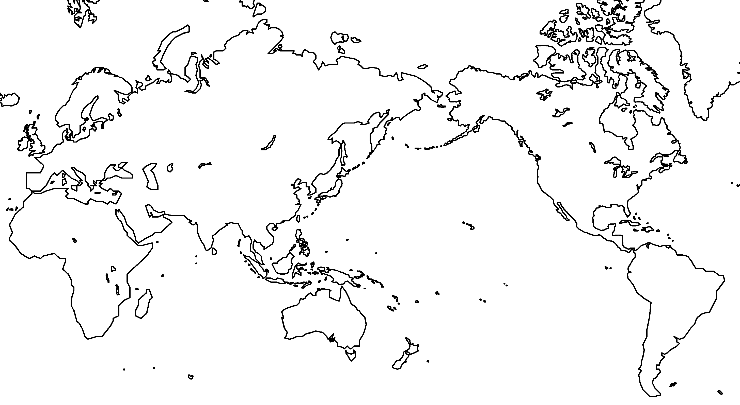
Overseas Research Units
CAS Central Asia Center for Medicine
CAS Central Asia Center for Ecology and Environment
CAS South America Center for Astronomy
Sino-Africa Joint Research Center
CAS South America Joint Lab for Space Weather

Slide 17






















































International Cooperation
Global network/connections: Hundreds of partners in over 90 countries
Academies & Research Institutions
Universities
MNCs
International Organizations

Slide 18
Blueprint for 2015-2030: The Pioneer Initiative
To consolidate CAS’ leading position in scientific excellence, high-caliber talent cultivation and think-tank service
To establish CAS as a world-class research institution

Slide 19
Blueprint for 2015-2030: The Pioneer Initiative
Action 1: Restructure CAS Institutes

Slide 20
Blueprint for 2015-2030: The Pioneer Initiative
Action 2: Optimize scientific deployment according to five priorities
Strategic and major scientific issues and challenges
space science, earth and ocean exploration, big data, cloud computing, smart
technology, cyber-security, quantum communication tech, mobile internet, etc.
Fundamental science, frontiers and inter-disciplinary research
quantum science, brain science, superconducting materials, etc.
Core technology for emerging industries
new energy, new materials, advanced manufacturing, etc.
National security
Health and sustainable development.

Slide 21




Blueprint for 2015-2030: The Pioneer Initiative
Action 3: Further reform talent & personnel management system
CAS President’s International Fellowship Initiative (PIFI)
Established
CAS President’s International Fellowship for Distinguished Scientists
CAS President’s International Fellowship for Visiting Scientists
CAS President’s International Fellowship for Postdoctoral Researchers
CAS-TWAS President’s Fellowship for International PhD Students
Early Career
Short Term
Long Term

Slide 22
Blueprint for 2015-2030: The Pioneer Initiative
Action 4: Further enhance the role as a national think-tank
Institute for S&T Strategy and Consultation
S&T Policy and Consultation
Innovation -driven
development
Ecological Civilization
Frontiers of Science
Strategic Intelligence

Slide 23
Blueprint for 2015-2030: The Pioneer Initiative
Action 5: Implement an open innovation strategy
Implement inter-nationalization strategy
Develop a national science & technology service(STS) network
Establish regional innovation systems
Develop national science platforms open to the public and the whole scientific community
Enhance domestic & international cooperation to further provide S&T service

Slide 24
Conclusion
CAS is the largest S&T organization in China with multiple roles and unique importance. The uniqueness of CAS in integrating R&D, education and strategic advice has proved to be an advantage to the organization in delivering high quality S&T, high-caliber talent and trusted ideas.
Despite challenges, we expect to continue to do well due to our legacy, culture and efforts.
International cooperation, a recipe for our success, will play an increasingly important role in our future.

Slide 25

CAS looks forward to
working with you !
www.cas.ac.cn

